Slide 1
Ph.D. of Computer Science: Oral Examination
Feasibility of Deception in Code Attribution
presented by
Alina Matyukhina
Supervised by: Dr. Natalia Stakhanova
Notes:
30 min presentation

Slide 2
The power of the Internet

Slide 3
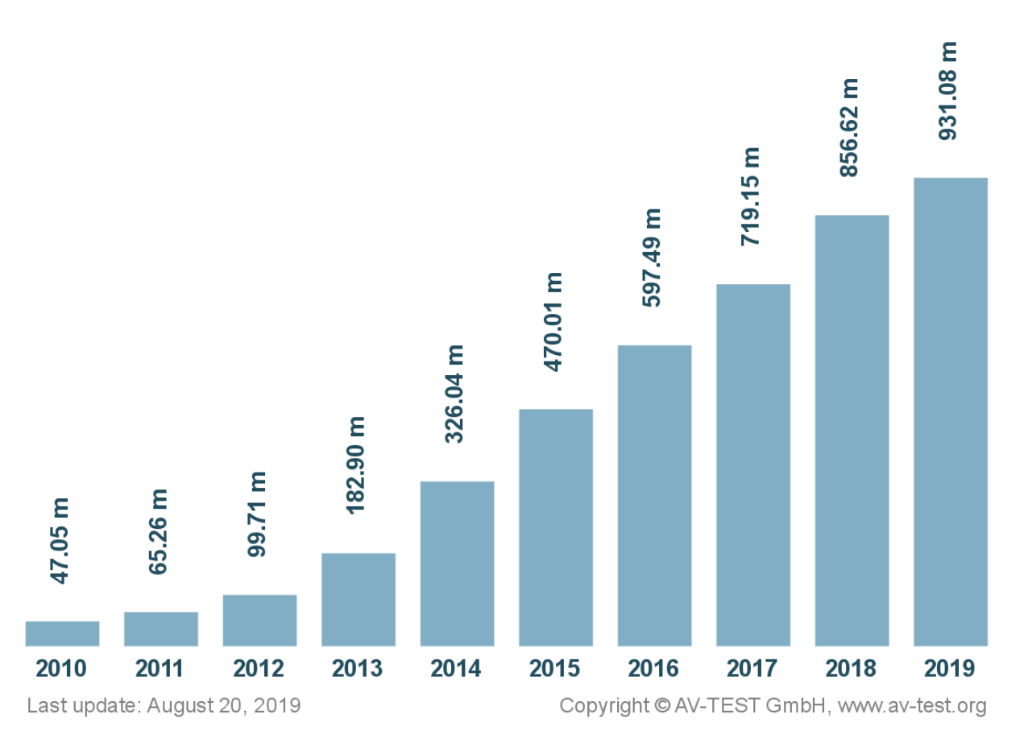
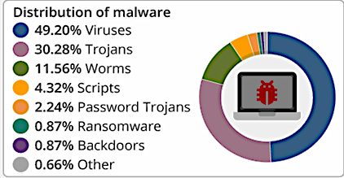
Cybercrime is one of the most prevalent and most popular rising crimes being committed today
Who is behind cyber attacks?
Total number of malicious programs in millions

Slide 4
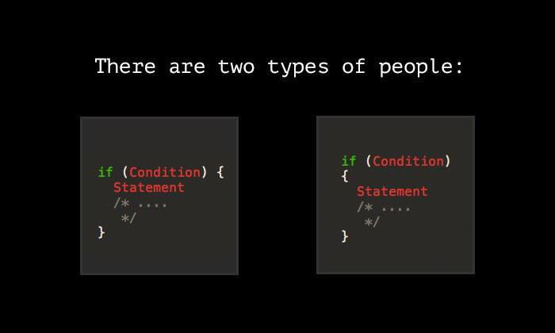
Code authorship attribution
Identification of a programmer based on stylistic characteristics of the code
Applications:
Malware analysis
Software forensics
Plagiarism detection

Slide 5
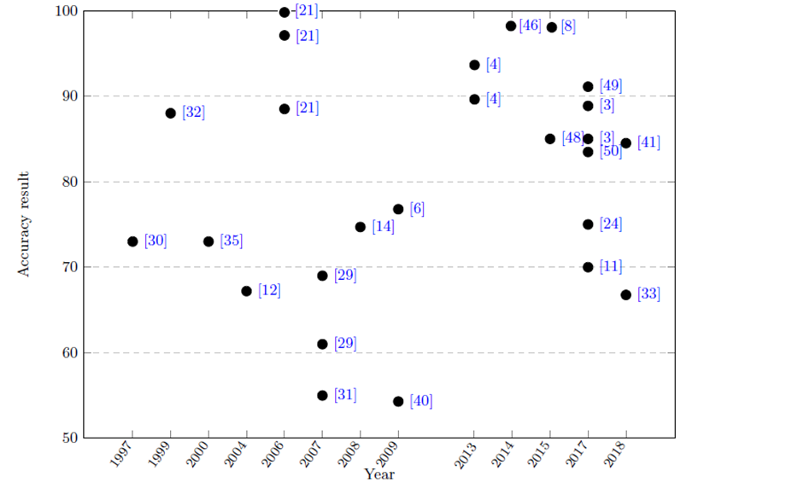
Code authorship attribution publications with the accuracies

Slide 6

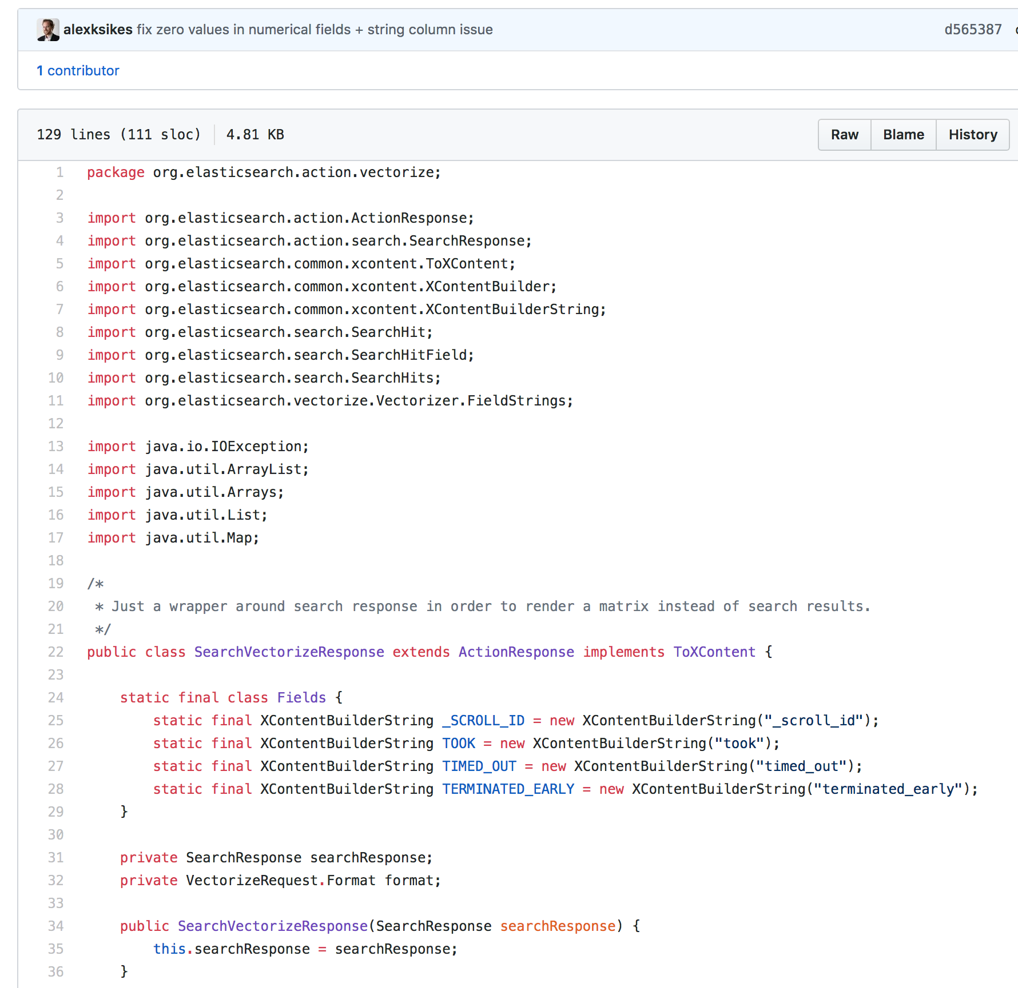
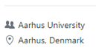
What we know about open-source contributors and how this information can be used?
Photo
Name
Activity
Education
Location
Coding style
Website
Coding style

Slide 7
Is it possible to deceive code authorship attribution techniques?

Slide 8
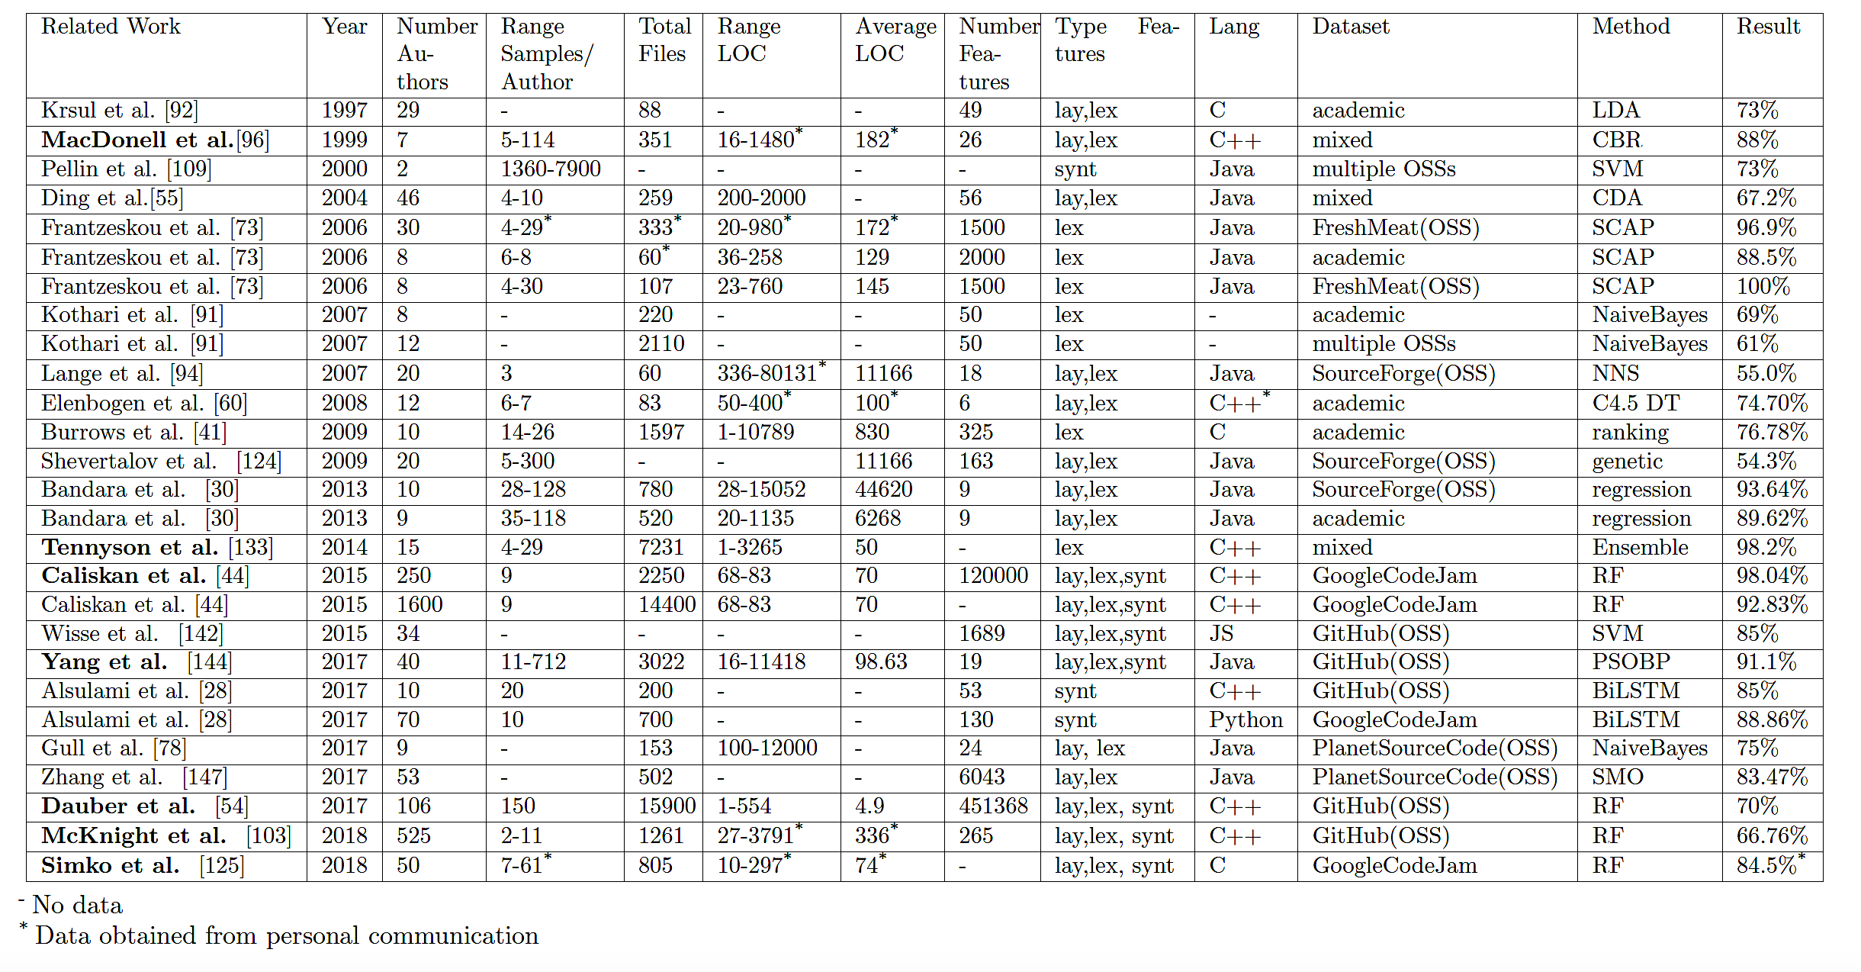
Previous studies in code authorship attribution

Slide 9
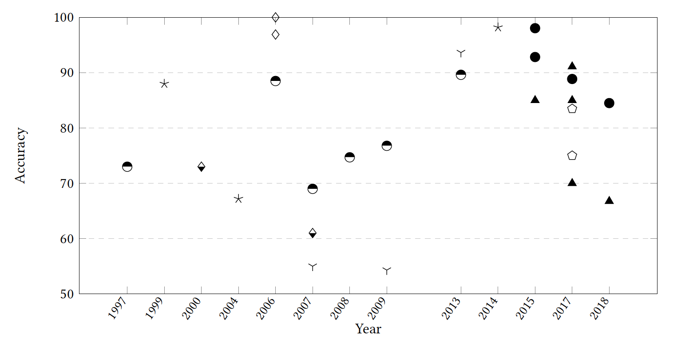
Timeline of attribution studies and the corresponding dataset sources

Slide 10
A need to find a common ground for code attribution studies
Code attribution studies are diverse: vary drastically in data size and source, features, and classification methods
Find a common ground by replicating previous studies and analysing their data
How much data (number of authors, samples per author, and length of samples) is enough to demonstrate the effectiveness of an attribution method?
Are these data characteristics dependent on the data source, data quality, and context?
What is the effect on the accuracy of code attribution if appropriate characteristics are not selected?
It is a necessary step toward understanding the robustness and potential weaknesses of current attribution methods

Slide 11
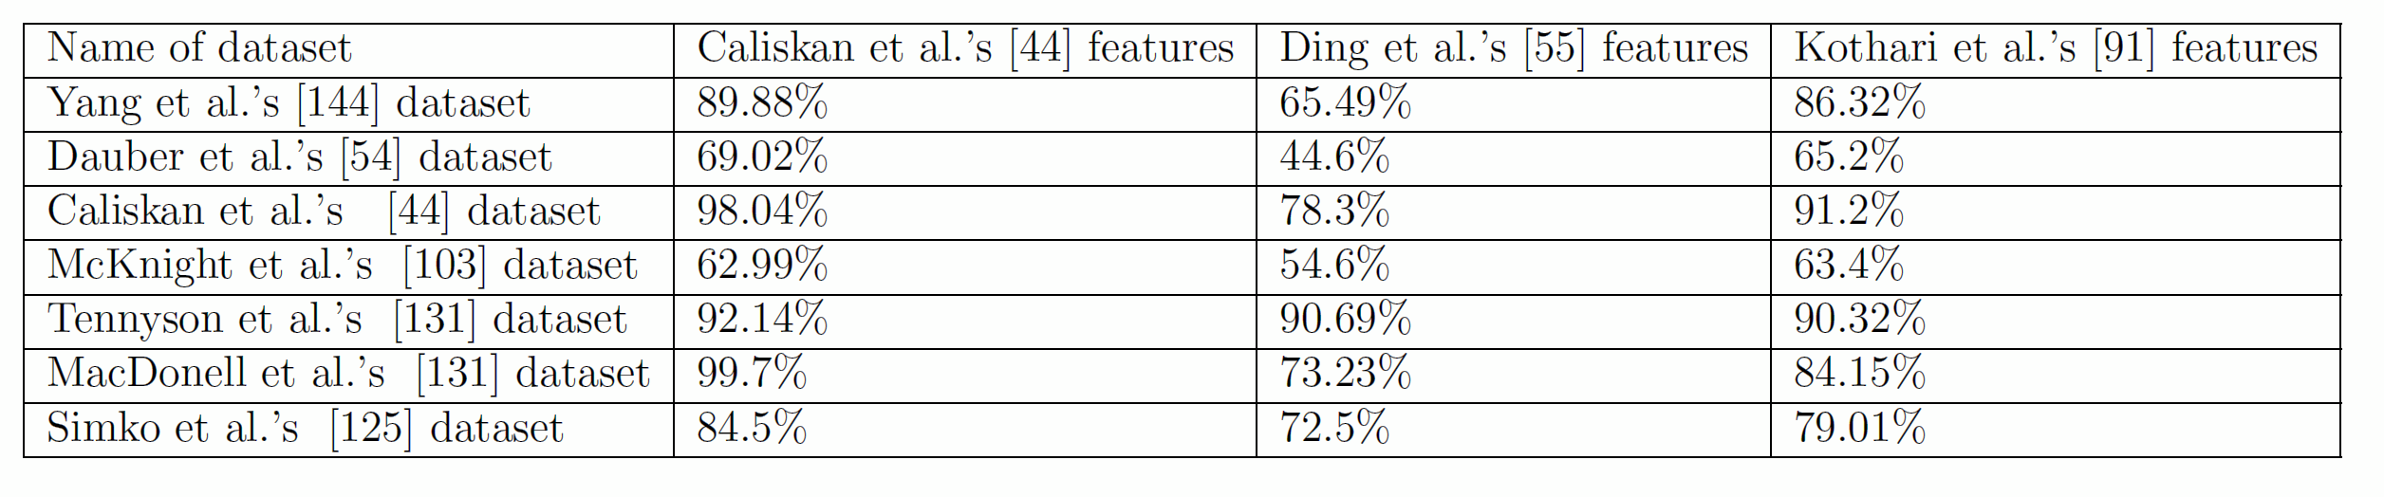
Results of our replication study
Results:
None of these feature sets can adapt to the changes in data
In a deployment setting, none of these techniques will produce expected results

Slide 12
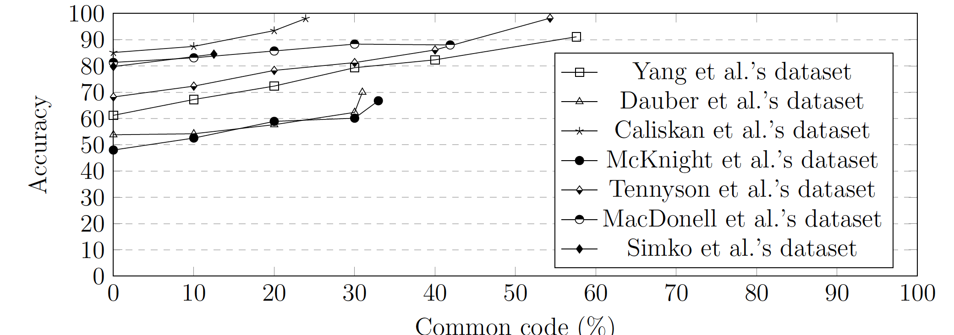
Results of our data analysis (Result I)
1. The reduction of common code leads to significant decrease in attribution accuracy
Removing 50% of common code decreases attribution accuracy by 25%, removing 30% leads to 15% decrease
Code similarity analysis is a necessary step to find how attribution technique can perform in the deployment

Slide 13
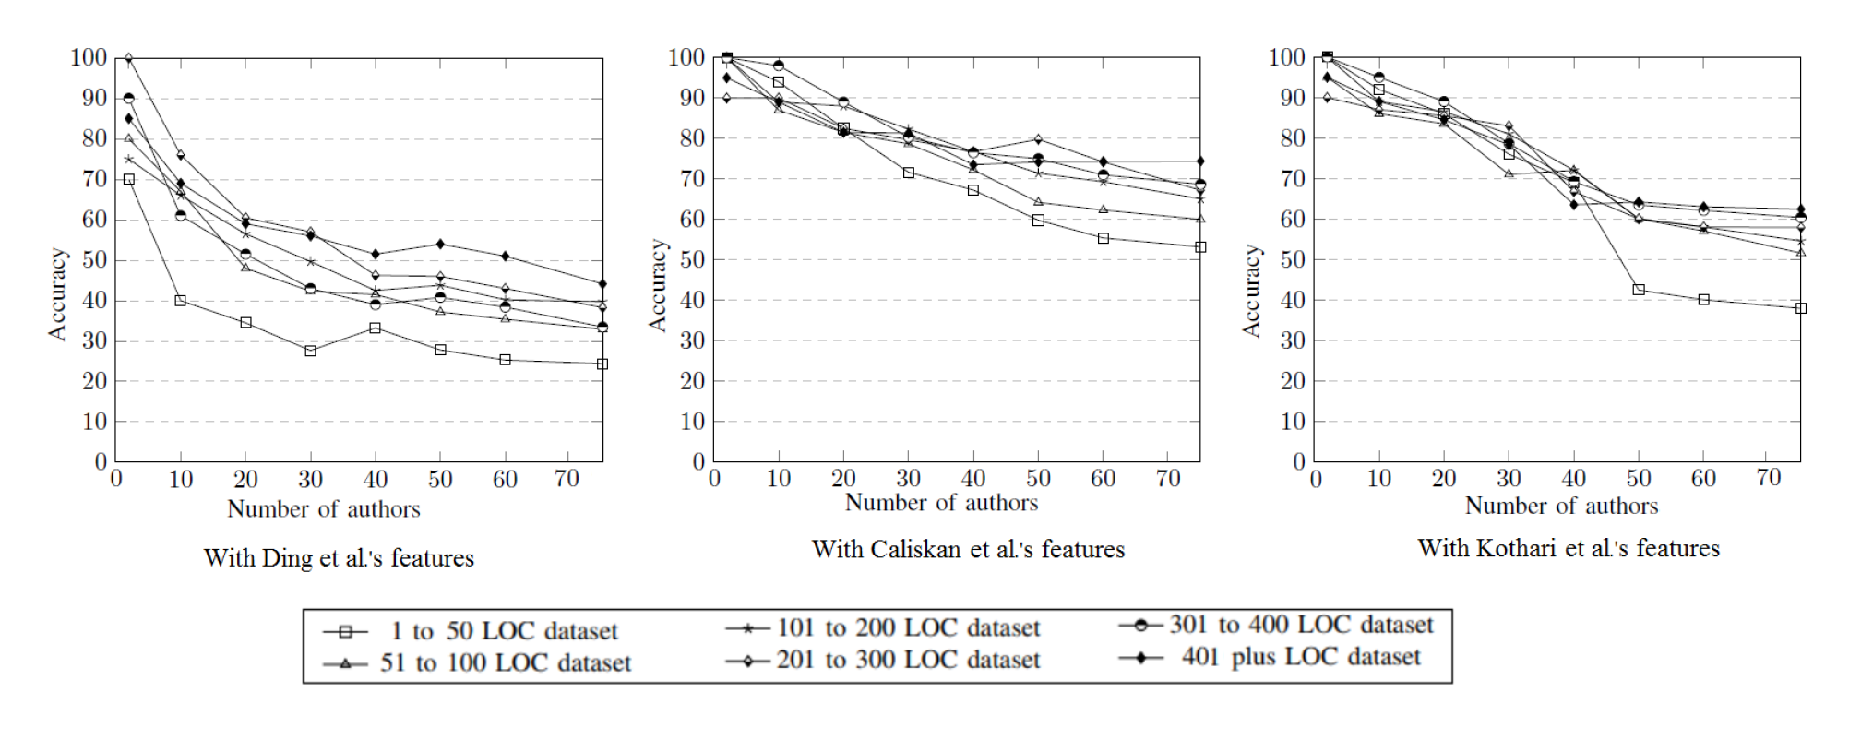
Results of our data analysis (Result II)
2. Attributing a large number of authors is challenging irrespectively of a code size and the number of samples per author
It is straightforward to attribute a small number of authors (less than 5 authors)
The most challenging is attribution of 40 authors and above

Slide 14
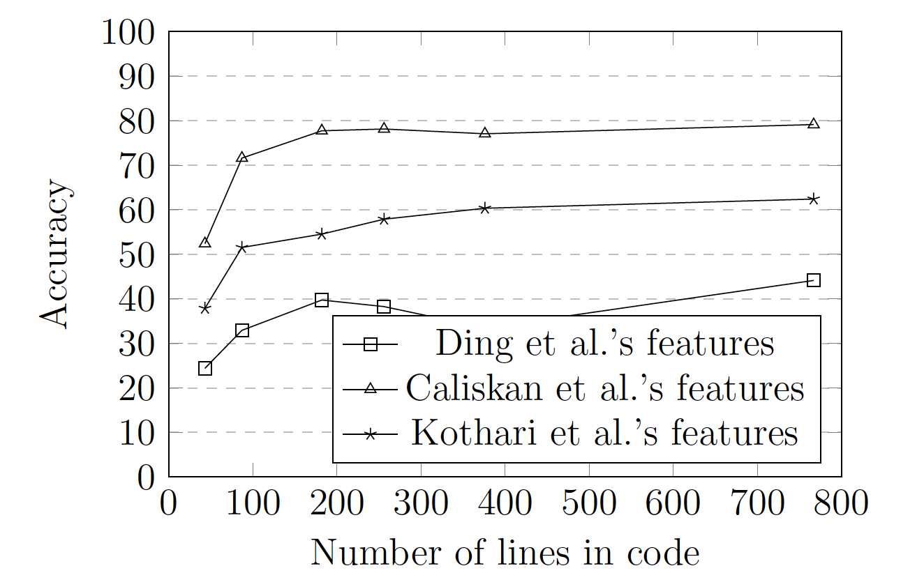
Results of our data analysis (Result III)
3. Large code samples do not always translate to better accuracy
The short samples from 1 to 50 LOC are the most challenging
The accuracy does not change significantly for programs with 200 LOC and above

Slide 15
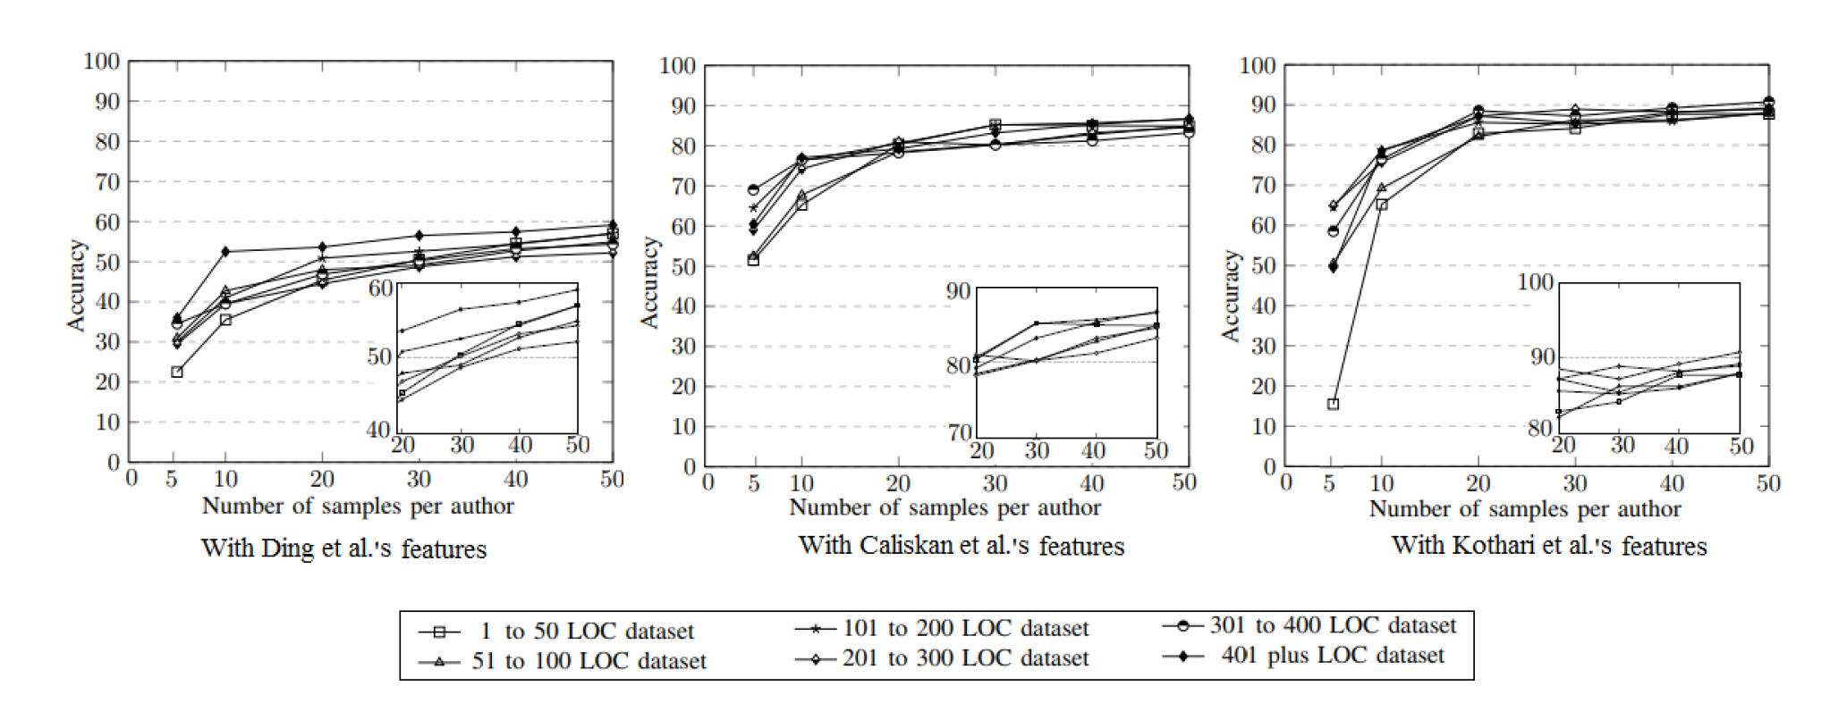
Results of our data analysis (Result IV)
4. Increasing the number of samples does not always result in a corresponding increase in accuracy
The accuracy of attribution in the presence of less than 10 samples depends on the size of available code
The accuracy does not change significantly for datasets with 30 samples of code and above

Slide 16
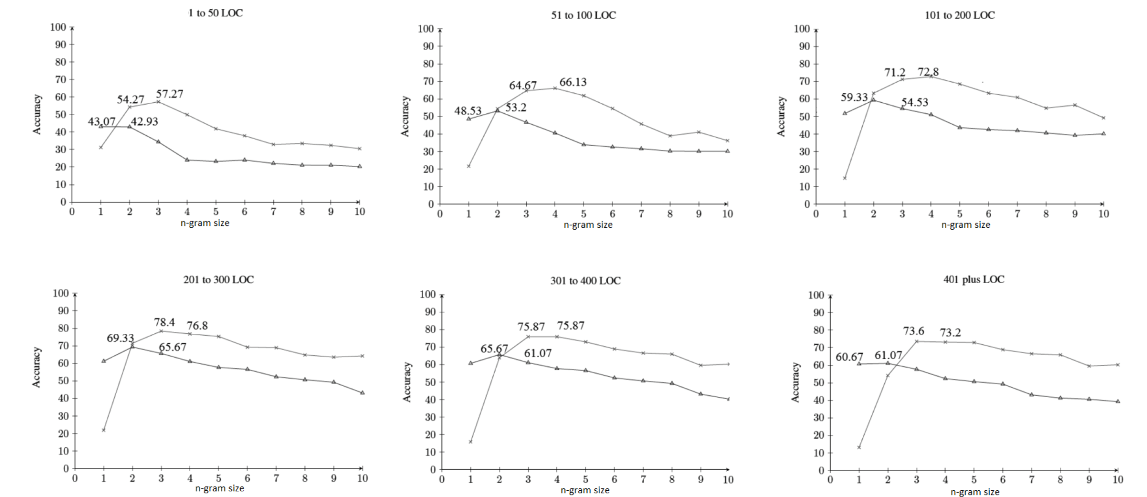
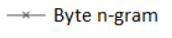
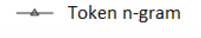
Results of our data analysis (Result V)
5. A performance of token and byte n-gram features highly depends on code size
Byte n-gram outperform token n-gram
Use byte 3-grams for short and large code, use byte 4-grams for code from 51 to 200 LOC

Slide 17
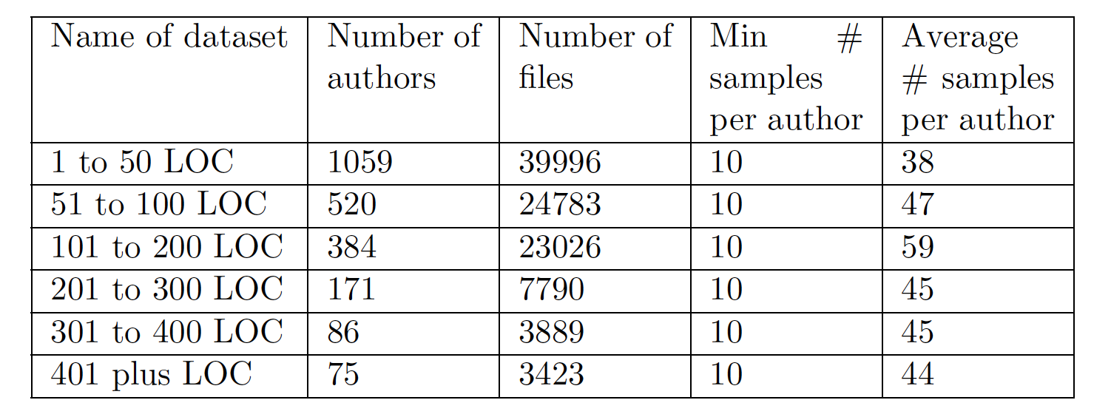
A large-scale reference dataset for code authorship attribution
Total 2056 authors with 47,288 source code of C programs with no common code
A software for extracting dataset for other languages with a customized number of authors, samples, and LOC [1]
[1] https://github.com/alinamatyukhina/Attribution_Real_World
Notes:
After our replication and data analysis, we found that open source and large-scale data is the most challenging for attribution task

Slide 18
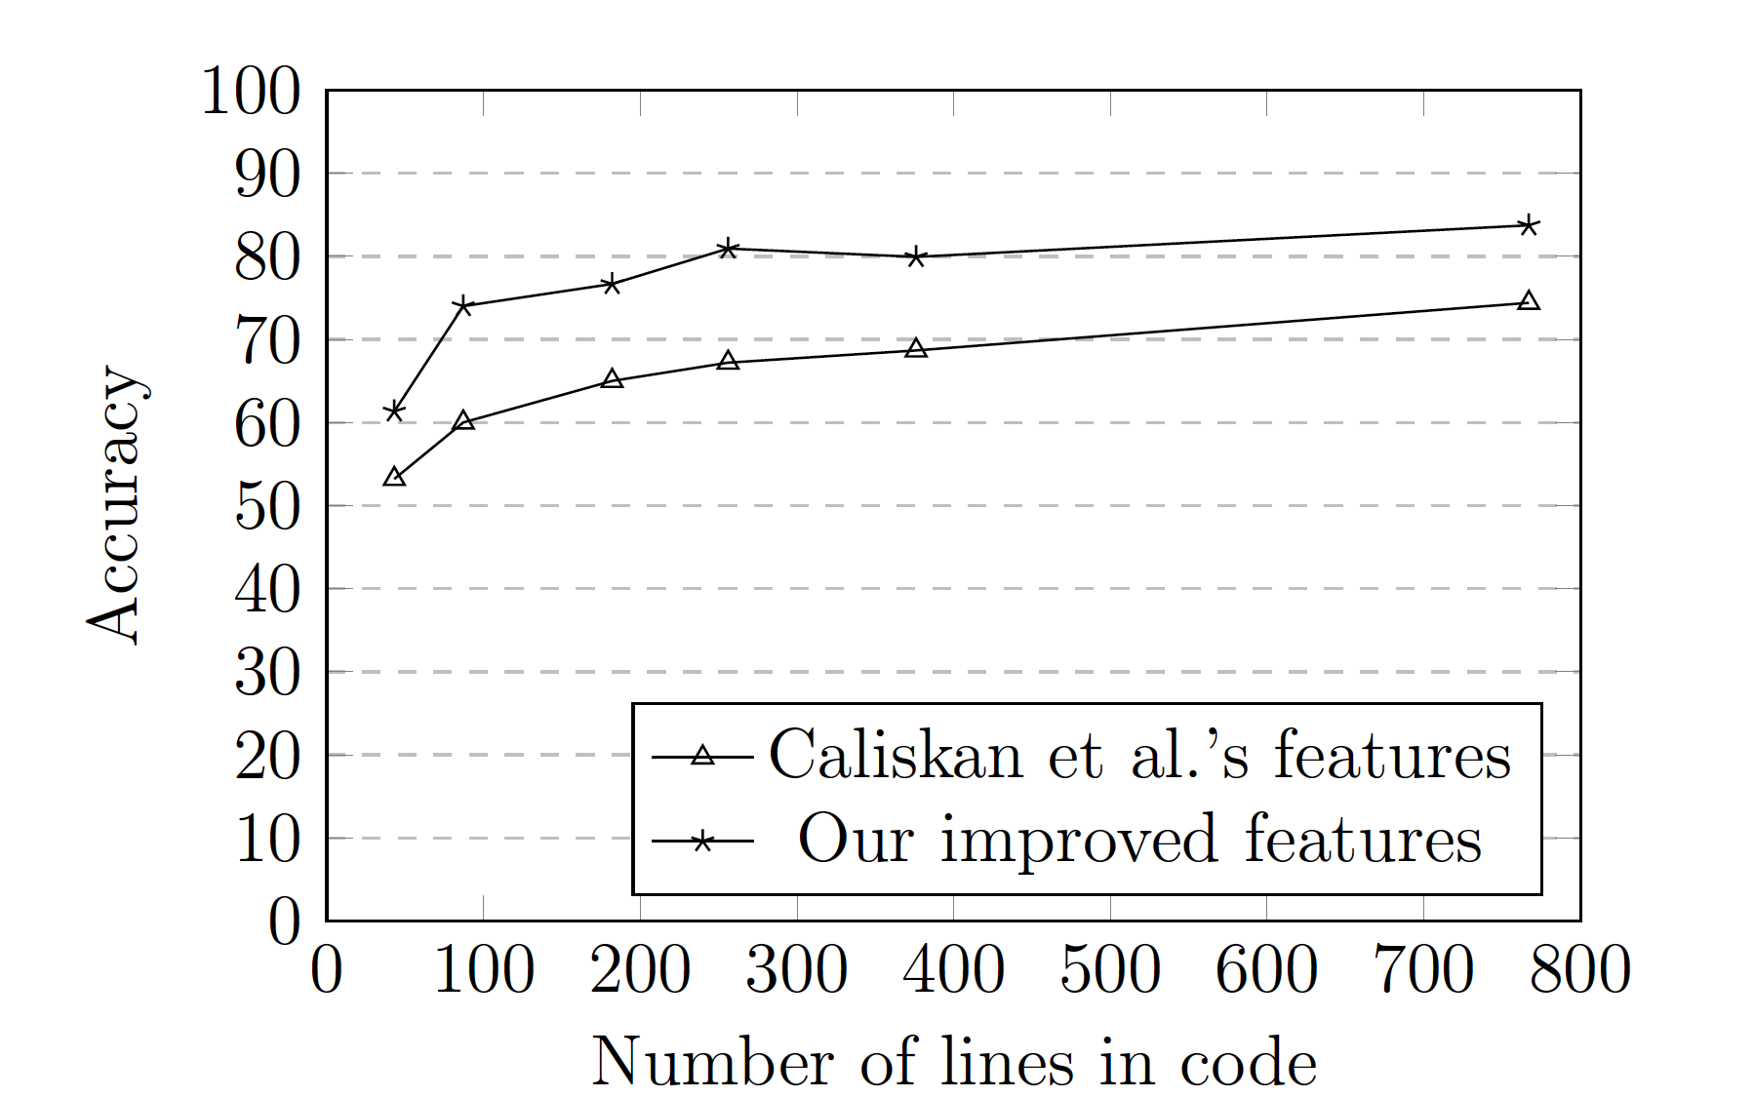
Our improved feature set
We defined the optimal feature sets for datasets of various sizes and offered them to the research community [1]
The accuracy of our improved features increases on average by 10% on every dataset
[1] https://github.com/alinamatyukhina/Attribution_Real_World
Notes:
Uncorellated caliscal features+ layout features+best performing n-gram

Slide 19
Can current attribution techniques be circumvented?
Based on our replication study and data analysis
The performance of current attribution techniques can be significantly decreased in the following cases:
removing common code in the dataset
only short samples from 1 to 50 LOC are available
only few samples per author are available
increasing number of authors in the dataset
How to deceive current attribution techniques?
Author imitation attack
The attacker attempts to write source code such that his/her coding style will be recognized as that of another specific author from open-source projects

Slide 20
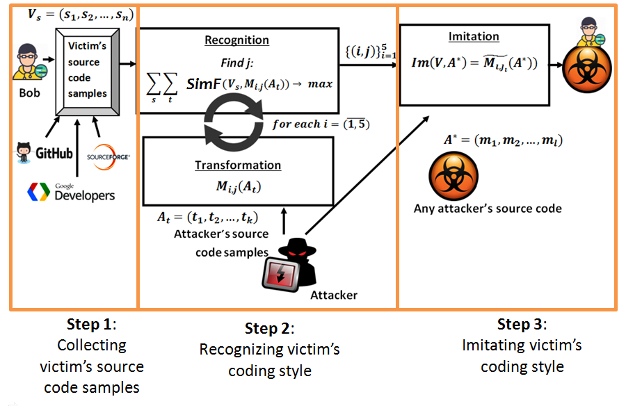
Attacking developer’s identity in open-source projects
Alex
V_{s}-victim’s code samples {s_{k}}_{k=1,n}
A_{t}-attacker’s code samples {t_{k}}_{k=1,n}
A*- any attacker’s code samples {m_{k}}_{k=1,l} for imitation attack
M_{i,j-} transformations, where
i- transformation level
j- transformation target
i=1 layout level
i=2 lexical level
i=3 syntactic level
i=4 control-flow level
i=5 data-flow level
SimF- similarity function

Slide 21
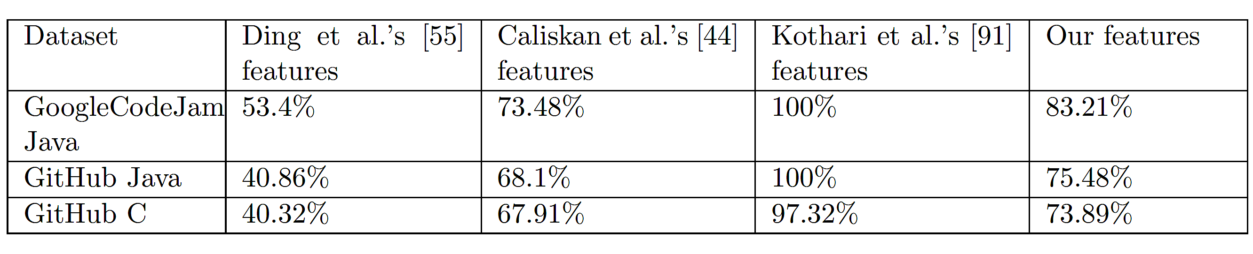
Accuracy of author imitation attack
%, percentage of successfully imitated authors
Result:
All existing attribution techniques are susceptible to author imitation attack

Slide 22
To mitigate an author imitation attack we propose an author obfuscation

Slide 23
Author obfuscation as a new kind of obfuscation technique
“Obfuscation provides a way to protect your code by making it unreadable using advanced algorithms and also reduces the size of your files for speed” [1]
The traditional obfuscation is not suitable for our purposes
We propose a new kind of obfuscation technique- author obfuscation:
Target the personal coding style
After obfuscation the code is still readable
[1] Collberg, Christian, Clark Thomborson, and Douglas Low. A taxonomy of obfuscating transformations. Department of Computer Science, The University of Auckland, New Zealand, 1997.

Slide 24
The proposed coding style transformations and their evaluation
Coding style transformations for author obfuscation:
Layout level (comments, curly brackets, indentation, lines)
Lexical level (names)
Syntactic level (AST leaves, AST nodes)
Control-flow level (control-flow logic, predicates, aggregation, ordering)
Data-flow level (literals, data, arithmetic)
Evaluation metrics:
complexity: how complex has the program become after the author obfuscation compared to original?
program size: PL=N₁+N₂
cyclomatic complexity: CC=E-N+2P
nesting complexity: NL=Av(NDL(statement))
readability: how easy to read and understand the obfuscated code? z=8.87-0.033V+0.40L-1.5E
resilience: how difficult to construct a tool to undo obfuscation and return code with original coding style?
cost: how much overhead is added to the obfuscated code?
file size (bytes)
execution time (sec)
detection: are current attribution techniques still able to detect the author of obfuscated code?
(acc(Caliskan et al.)+acc(Ding et al.)+acc(Kothari et al.)+acc(Improved features))/4

Slide 25
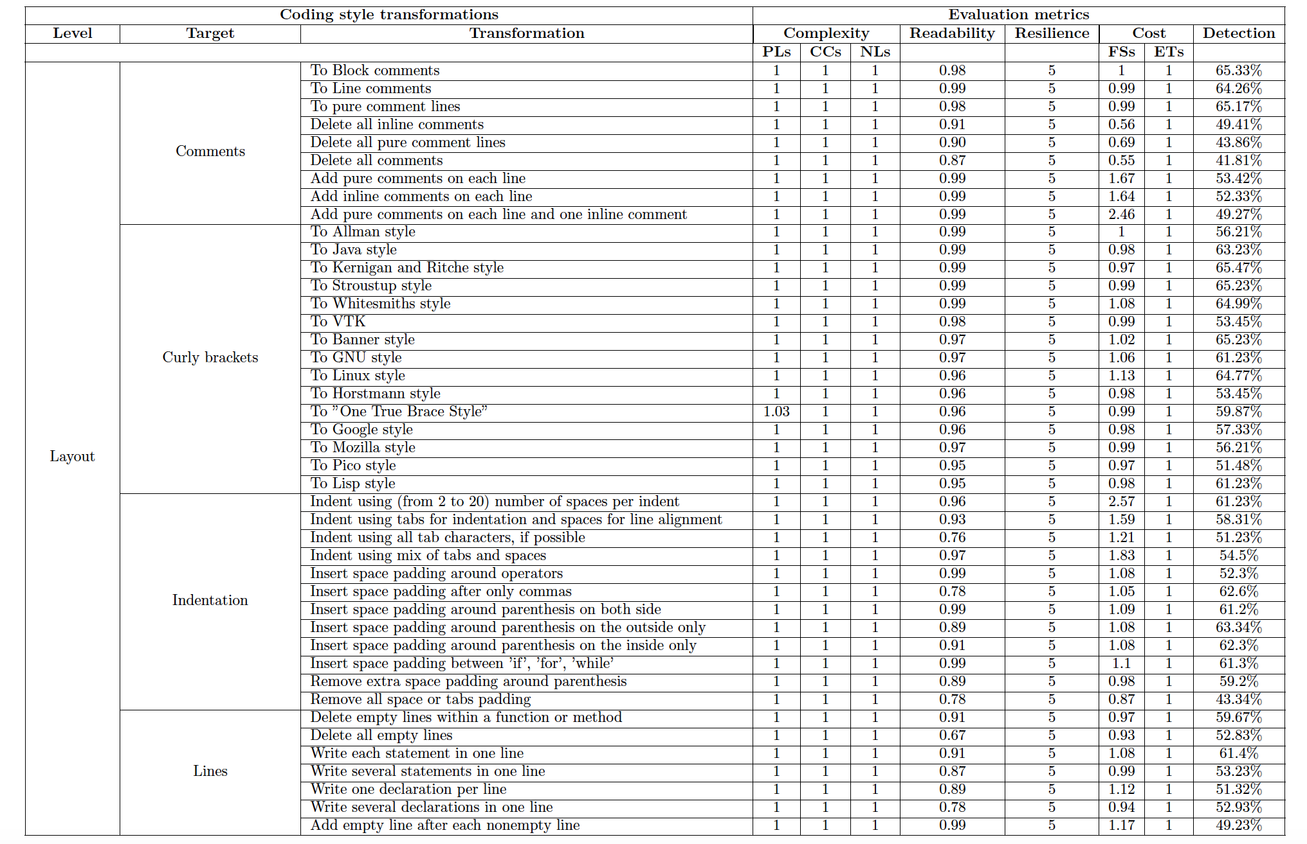

Slide 26
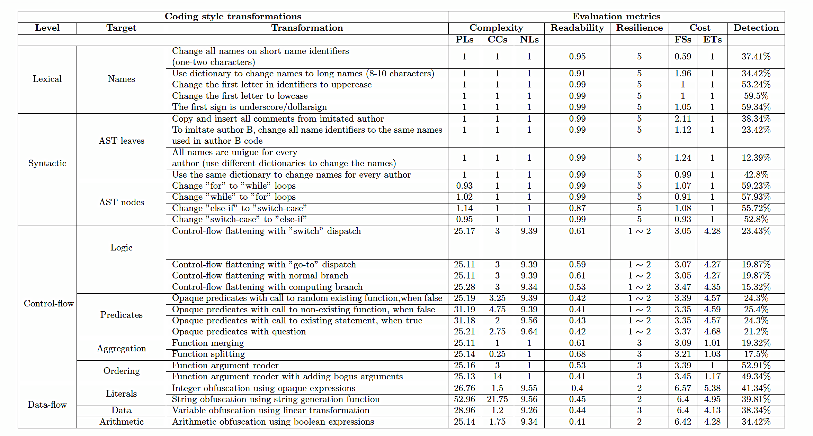
Almost every layout and lexical transformations were low cost and preserved readability
2. The rest of syntactic, control-flow, and data-flow transformations made the target program much slower, larger, and much harder to read
3. None of these transformations alone can fully hide the code

Slide 27
The proposed author obfuscation methods
“HideBySim” author obfuscation works individually with each author
Generalization of author obfuscation method for any author
“MaxiCode” and “MiniCode” author obfuscation
Let P → P’ be a transformation of a source program P into a target program P’. In order for P → P’ to be a “HideBySim” obfuscation the following steps should be applied:
Apply a set of transformations T_{n} from the list of possible transformations T on program P
Select those transformations T_{i} so that SimFun(a,b)→ min
Input: Dataset V_{s} with authors s and their code samples m; List of possible transformations T
Output: Set of transformations T_{k} from T
for all V_{s} do
apply each transformation T_{i} from T
if after transformation T_{i} attribution fails to attribute code samples m to all authors s then
return T_{i}
return T_{k}={T_{i}}^{l}_{i=1}

Slide 28
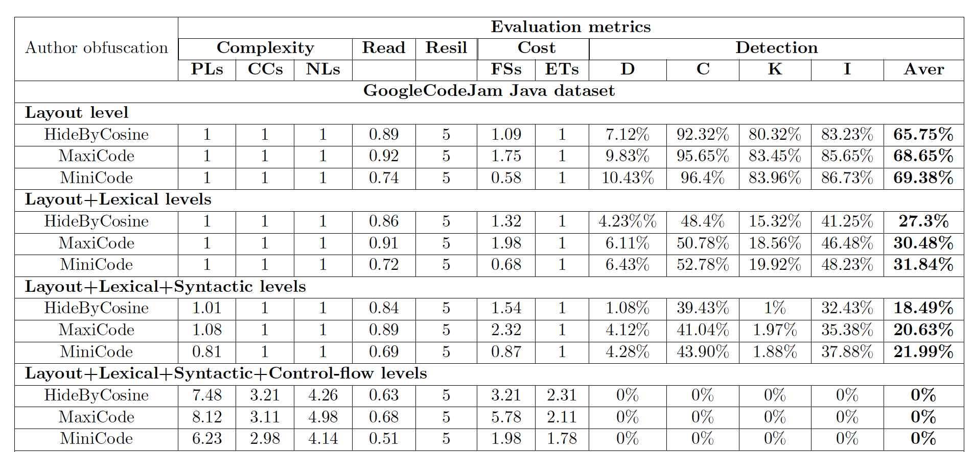
Results of author obfuscation methods on GoogleCodeJam Java dataset

Slide 29
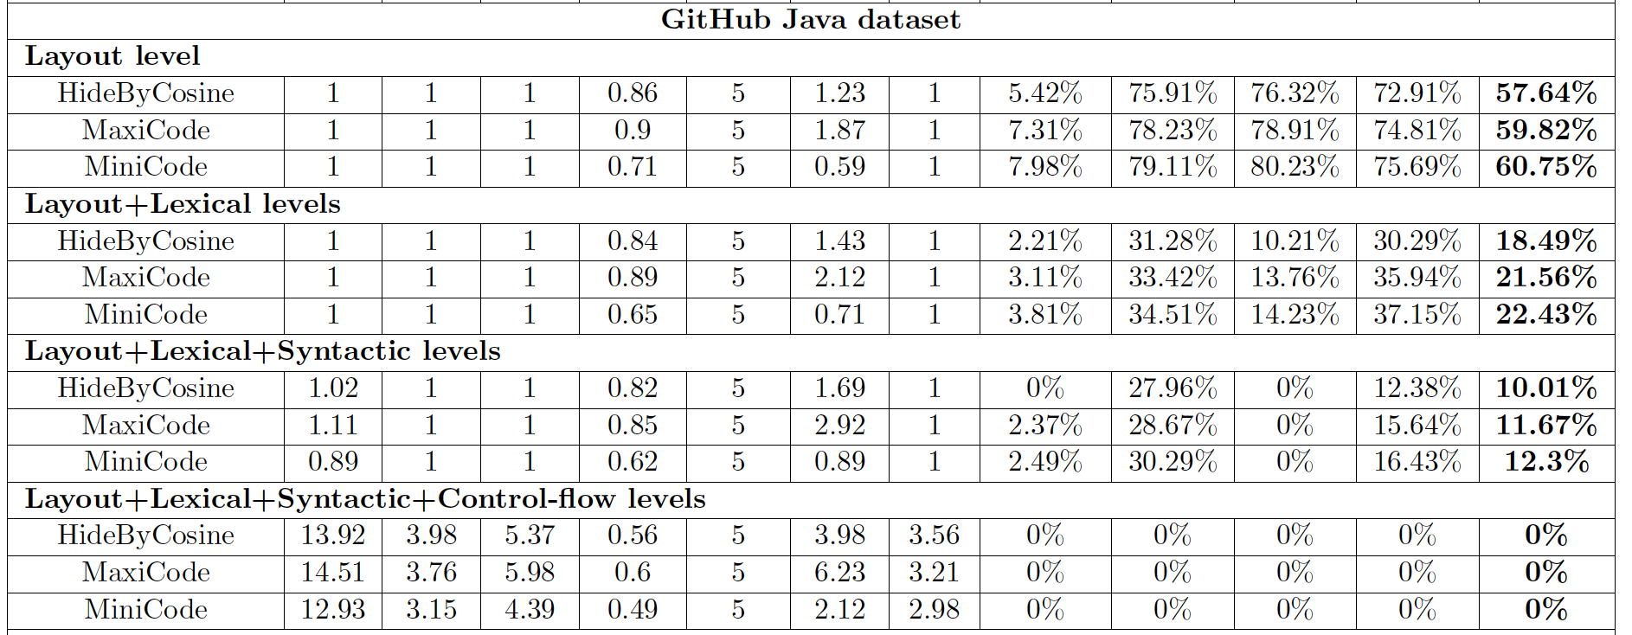
Results of author obfuscation methods on GitHub Java dataset

Slide 30
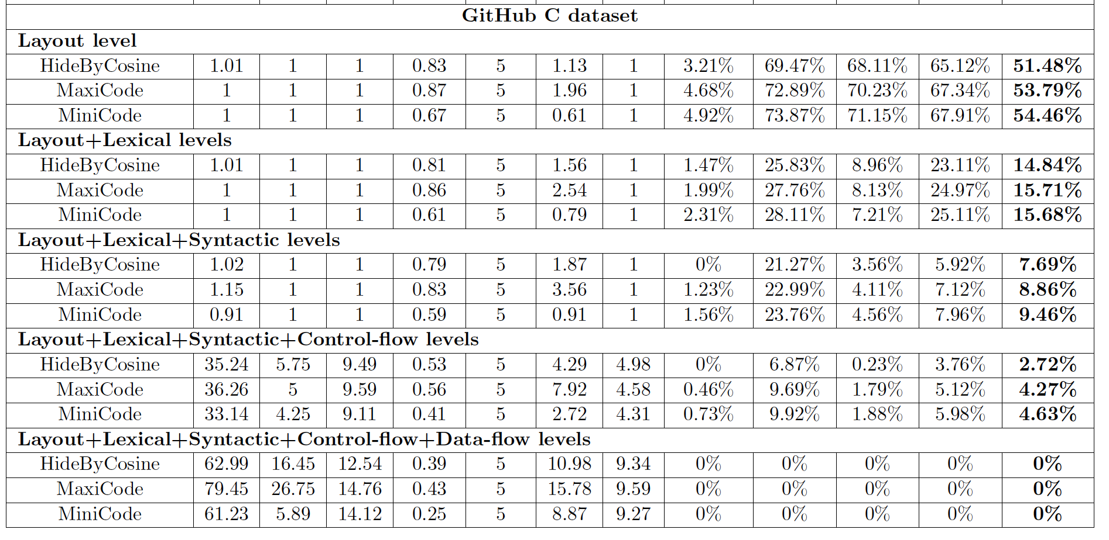
Results of author obfuscation methods on GitHub C dataset

Slide 31
Main contributions
An author imitation attack against authorship attribution
existing attribution techniques could be deceived by author imitation
2. New author obfuscation techniques as a mitigation strategy
a set of coding style transformations, which target only the coding style, unlike existing obfuscation tools
several author obfuscation methods were proposed: “HideByCosine”, “MaxiCode”, and “MiniCode”
these techniques allowed us to hide entirely the coding style of the author (the accuracy of the existing attribution methods reduced to 0%)
3. Automated measures for evaluation of author obfuscation methods
complexity
readability
resilience
cost
detection
An optimal set of data and feature characteristics for authorship attribution task
the effect of common code, source code size, samples size, and author set size on attribution accuracy
5. A comprehensive open-source dataset for authorship attribution
the approach to construct attribution datasets from open-source repositories with no common code

Slide 32
Thank you!

Slide 33
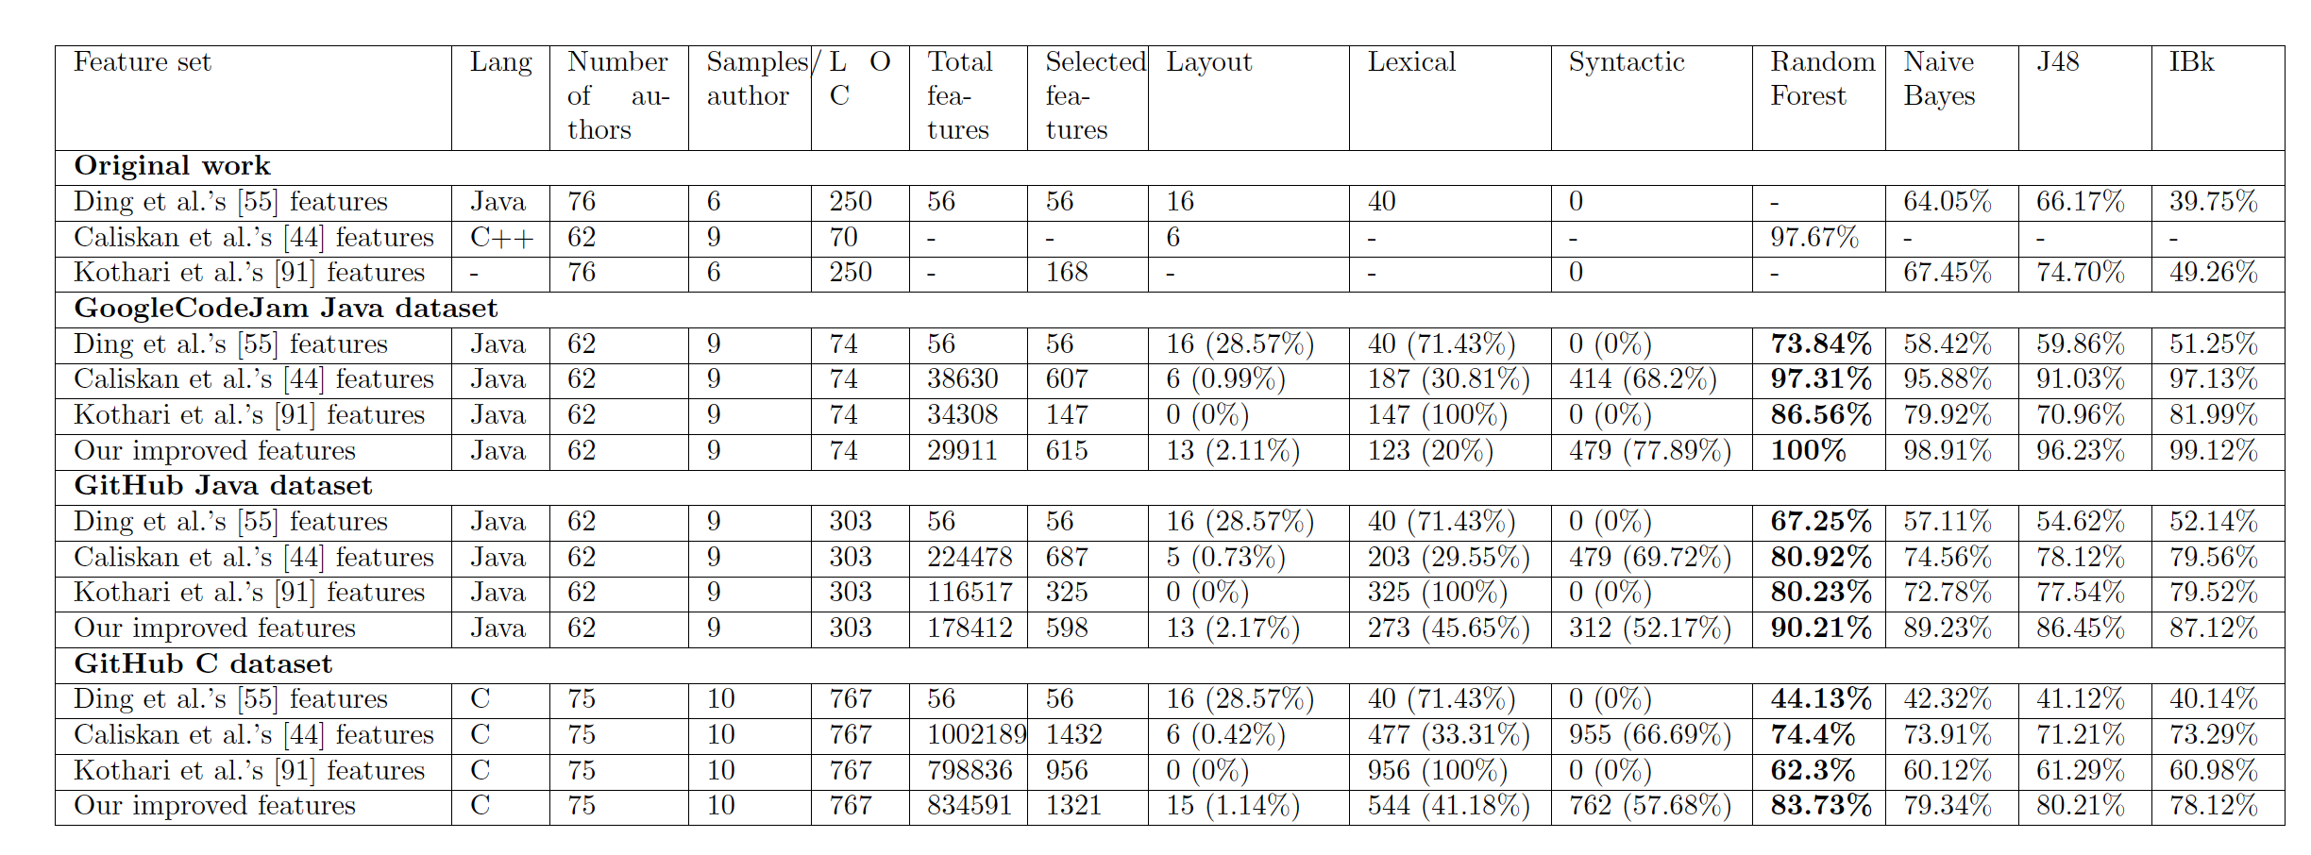
The details of our datasets and classification results for adversarial attribution
Av=89.43%
Av=79.65%
Av=66.14%

Slide 34
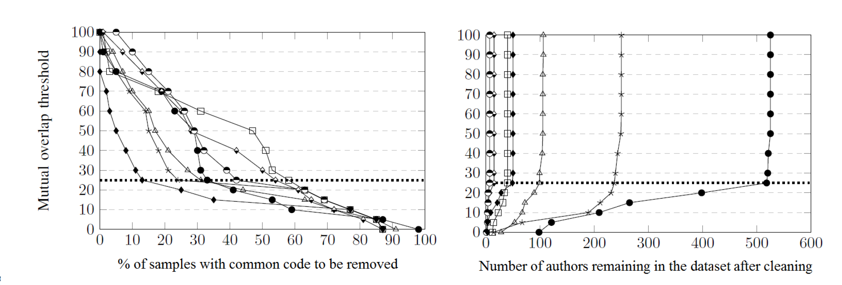
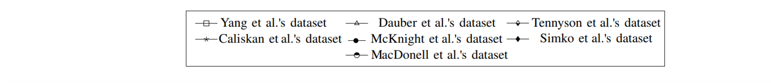
Presence of common code in datasets

Slide 35
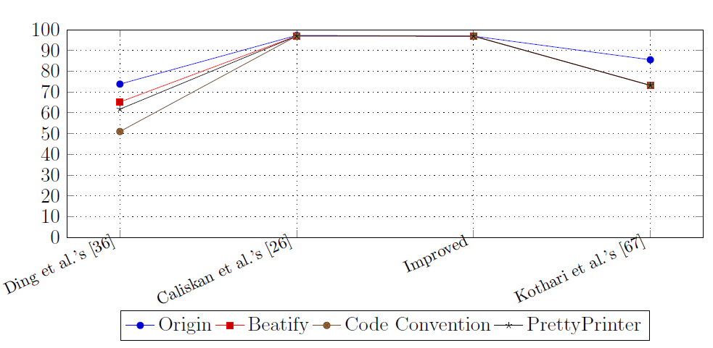
Attribution accuracy does not produce significant change after formatting

Slide 36

Adversarial model for code attribution
Our assumption: the adversary thinks objectively to reach a given goal, according to his/her knowledge of the attribution system, and his/her capability of manipulating data.
Adversary's goals:
Decreasing the level of confidence
Untargeted misclassification
Targeted misclassification
Adversary's knowledge:
White-box attack
Grey-box attack
Black-box attack
Adversary’s capabilities:
Manipulating training dataset
Manipulating testing dataset
Control on features

Slide 37
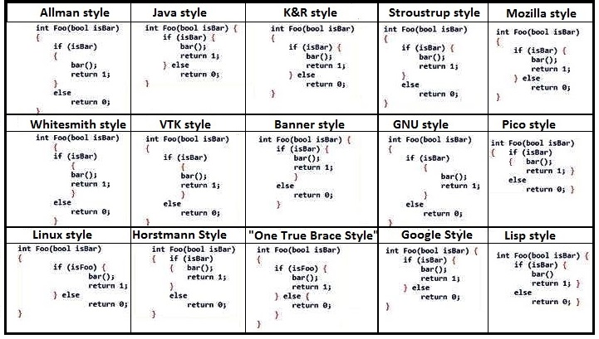
Layout transformations (curly brackets)

Slide 38
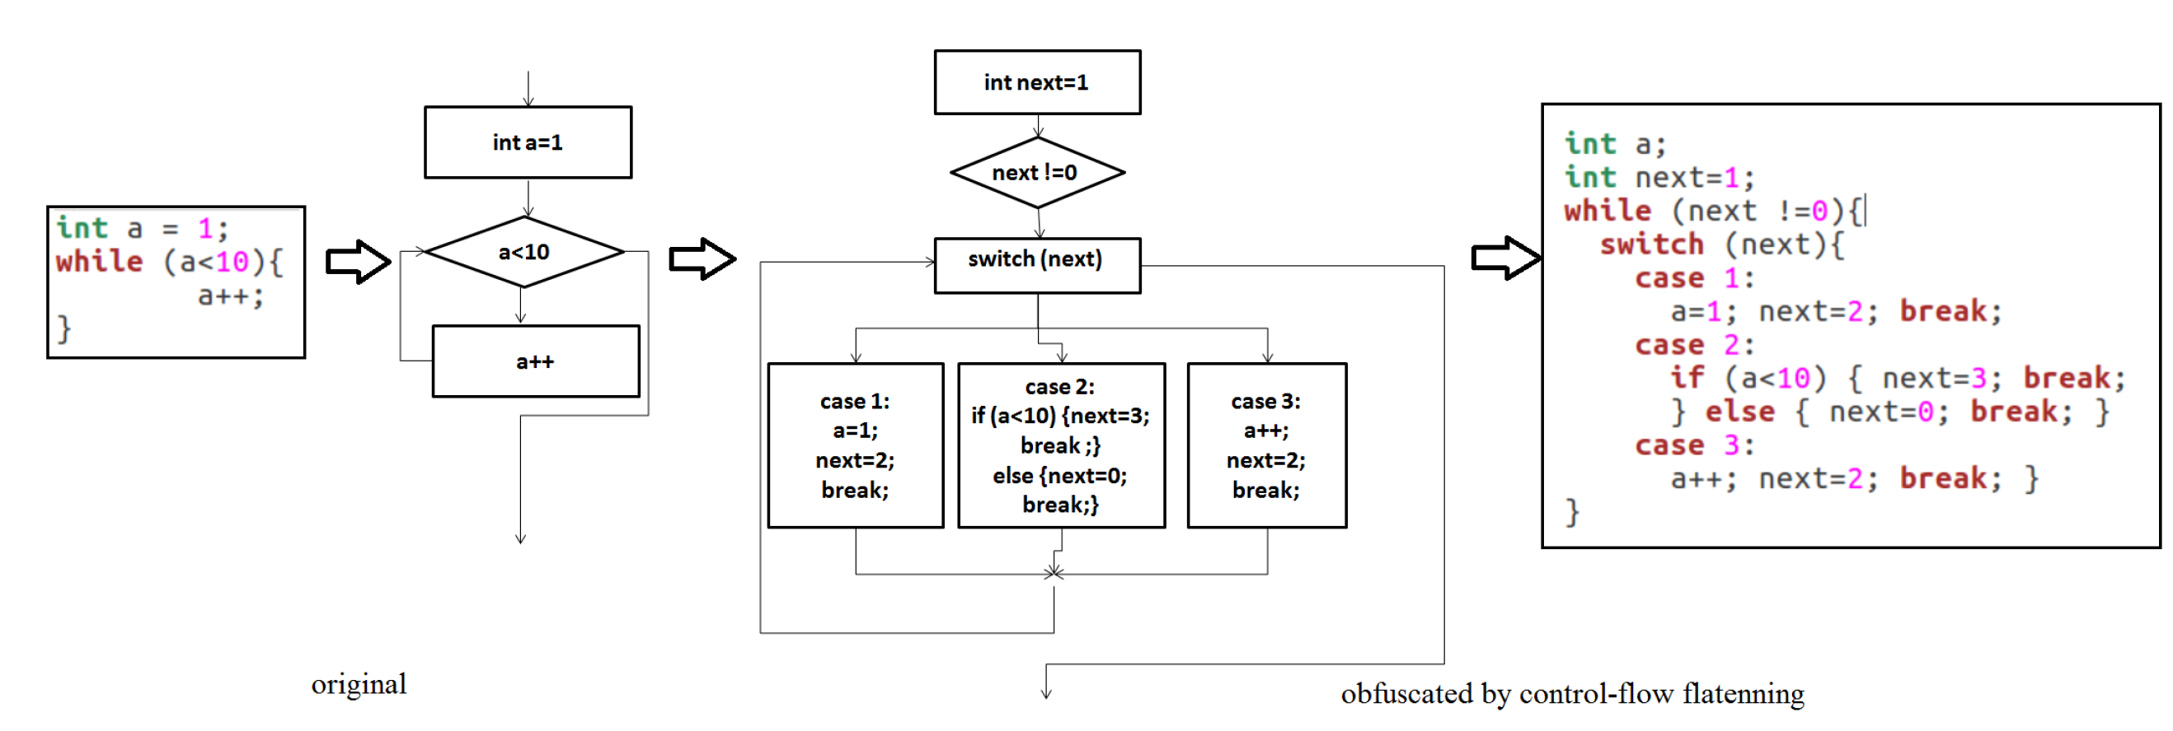
Control-flow transformations (control-flow flattening)

Slide 39
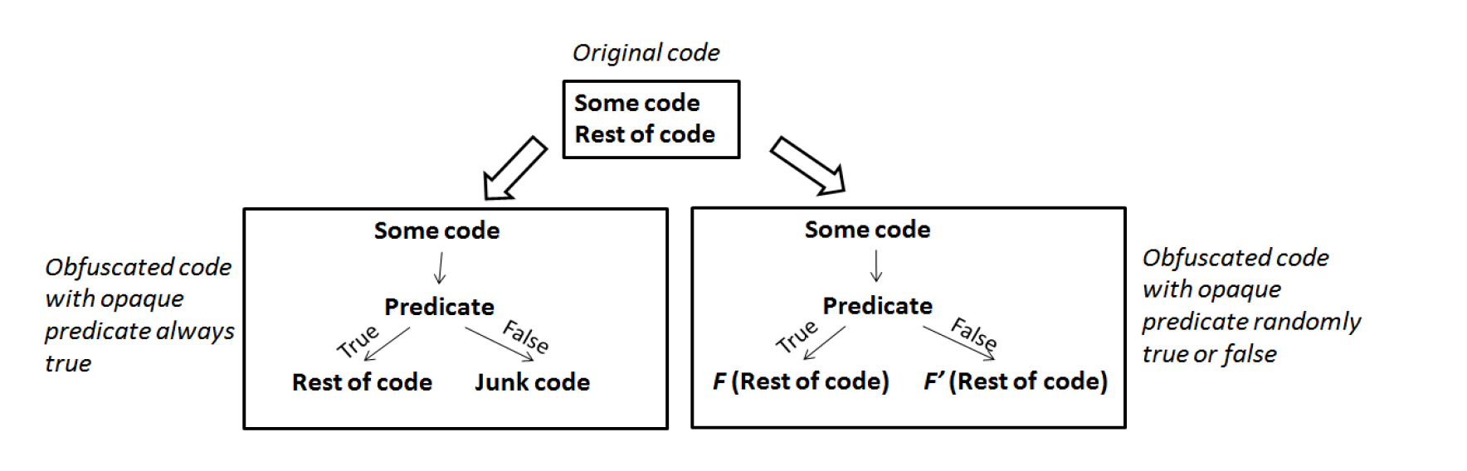
Control-flow transformations (opaque predicate)
A predicate is a conditional expression, which is mainly created from well-known algebraic theorems.
Predicate (x³ –x= 0(mod 3)) is opaquely true for all integers x, and x² < 0 is always false for any integer x.

Slide 40
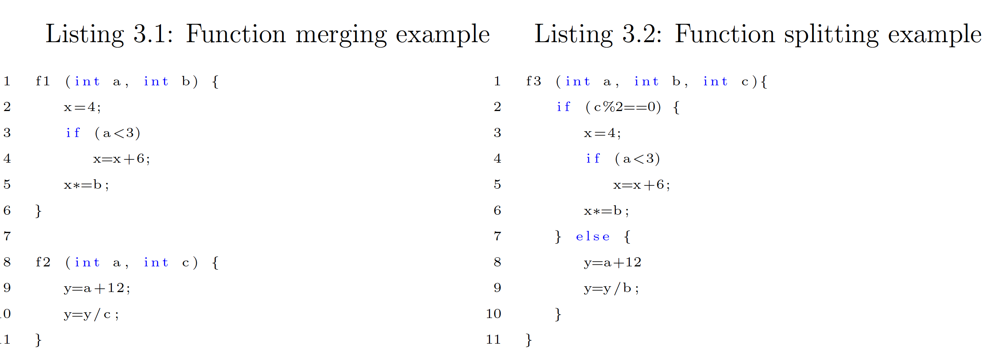
Control-flow transformations (aggregation)

Slide 41
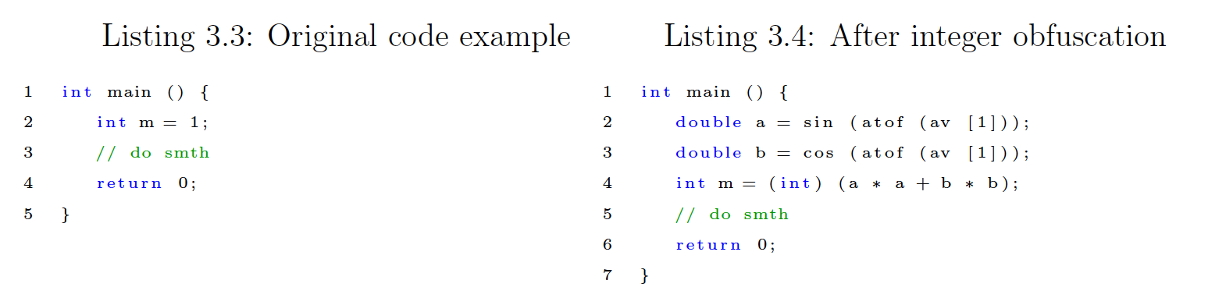
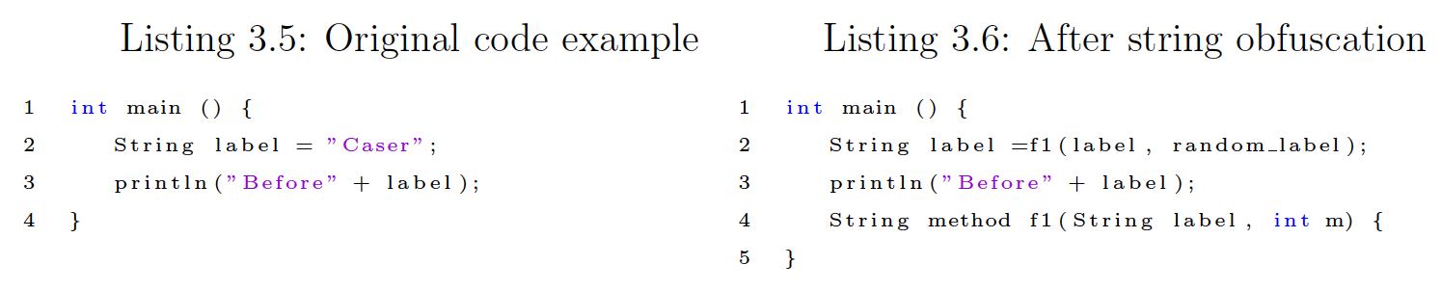
Data-flow transformations (literals)

Slide 42
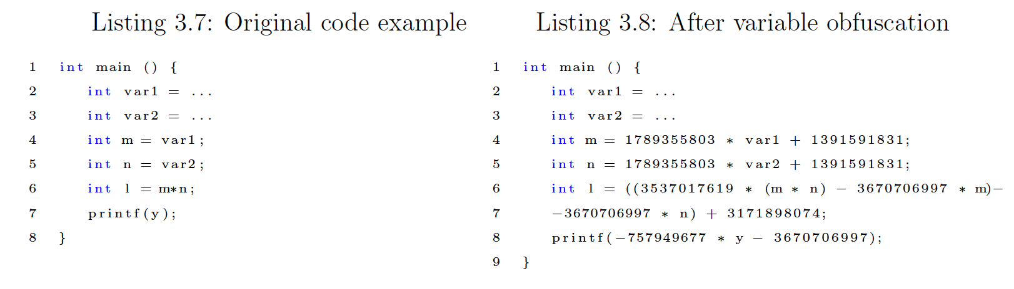
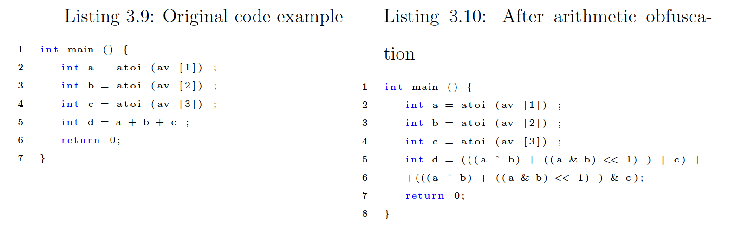
Data-flow transformations (data and arithmetic)

Slide 43
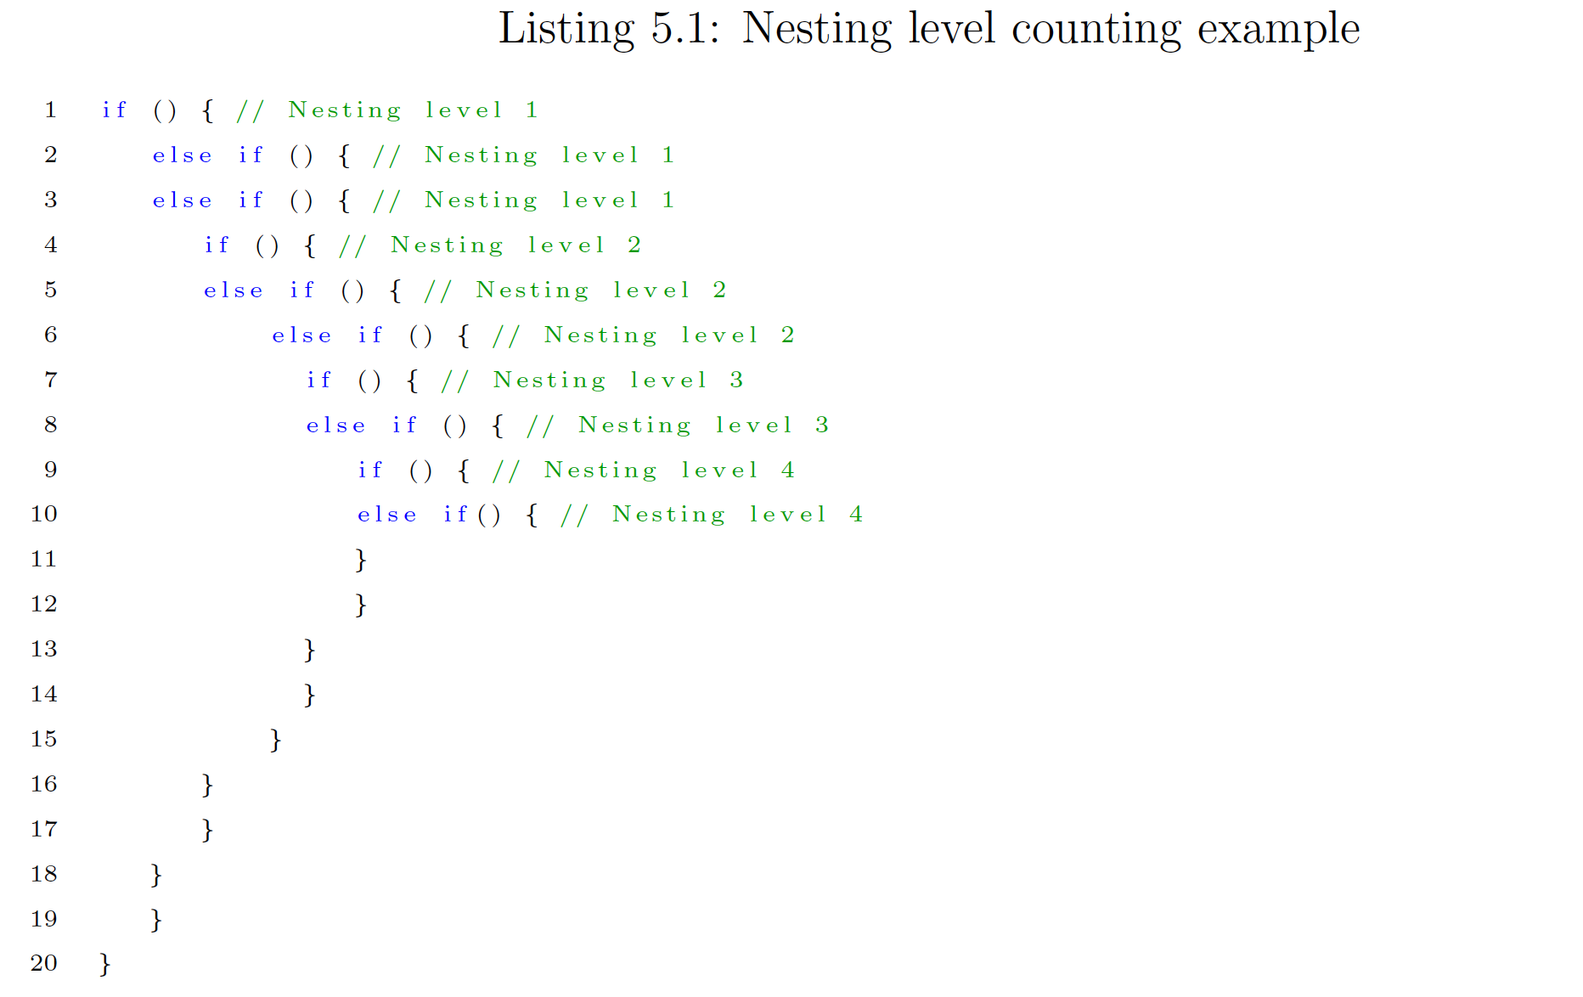
Nesting level counting example
Sum(10 executable statements)=23
Av=23/10=2.3

